Slide 1

An Evolution of Visualization

Slide 2
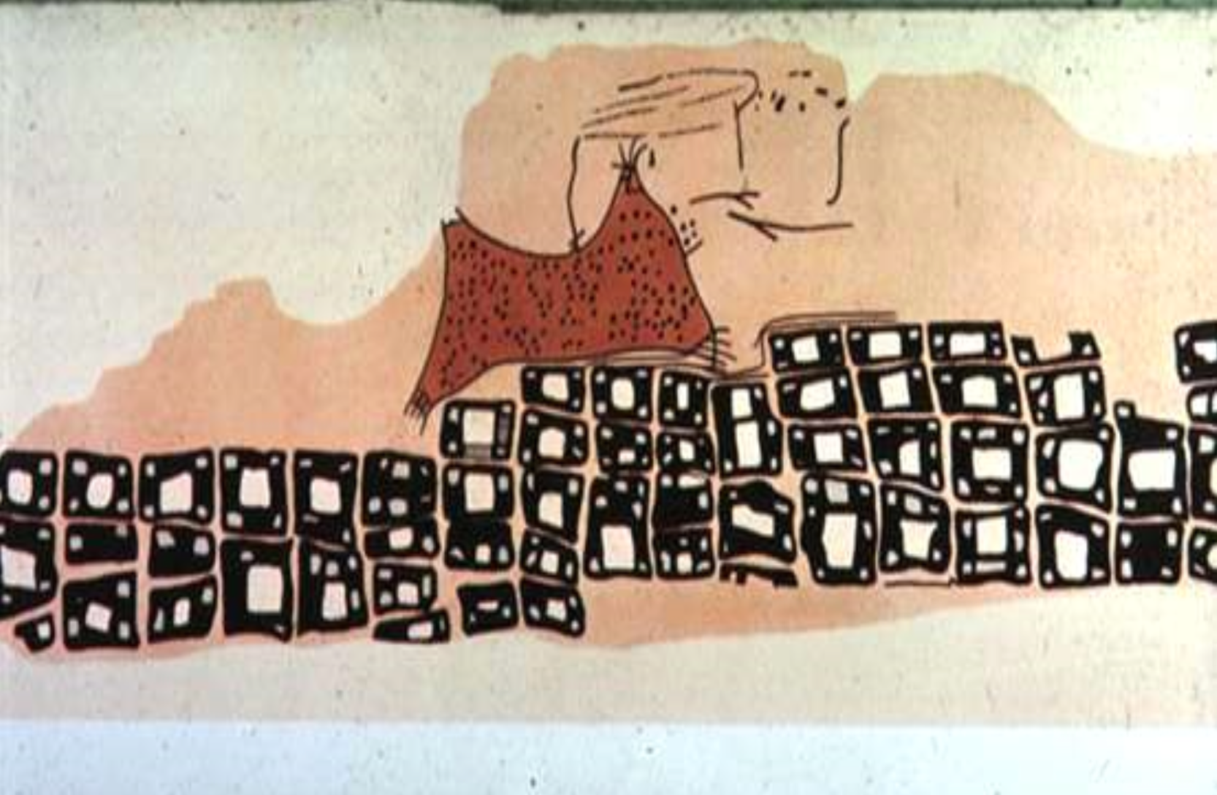
The First Data Vis
Notes:
~6200 BC Town Map of Catal Hyük, Konya Plain, Turkey
From Heer

Slide 3
Playfair
“Golden era” of modern graphics
Notes:
traditionally, computed statistics (by hand) are transformed into hand drawn displays
here, a mental model of the data is encoded by Playfair that takes compiled government data
and plots it visually to make it more understandable
René Descartes inspired the cartesian coordinates

Slide 4
Notes:
the tools are recording, computing, sketching by hand, and engraving into templates for print!

Slide 5
Notes:
or, depending on the medium, painting for your particular audience
Florence nightengale

Slide 6
Notes:
minitab!

Slide 7
Notes:
general purpose scientific plotting packages

Slide 8
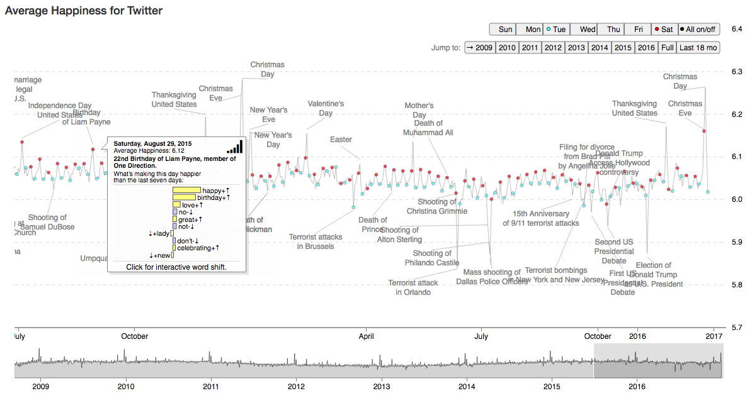
Notes:
online, interactive vector graphics!

Slide 9
Modern Tools of the Trade
Microsoft Excel
Adobe Illustrator
Tableau
R’s ggplot, Python’s matplotlib
Plotly
D3

Slide 10
Trade-Offs
Scriptable
Speed of iteration
Customizability
Support vector graphics
Interactive
Handle big data
Lines of code needed

Slide 11
Changing Frameworks
Engraving, sketching/painting
Rendered pixel-based graphic (rasters)
(PNG, JPG, BITMAP)
Vector graphics (PDF, SVG, AI)
Interactive (QTK, Web browser)

Slide 12
Visualization Backend Summary
Paper
ASCII
QTK
PNG
SVG
PDF
WebGL

Slide 13
Rasters vs. Vectors
File size
(many points)
Resizing
Portability
Notes:
Rasters scale O(1), vectors scale O(n)
Keynote doesn’t accept SVG

Slide 14
Powering Interactivity
Operating system–specific libraries
Web browsers

Slide 15
Grammar of Visualization

Slide 16
Software Implies the Model
Tableau/Excel: choose a chart
Illustrator: layout and alignment
Matplotlib/ggplot: plot() for time series
D3: data bound to visual elements

Slide 17
Grammar of Visualization
plt.plot(x, y)
qplot(x, y)
Notes:
plt.plot(time, sales) … plt.scatter(sales, profit)
plt.plot(time, sales, profit)

Slide 18
Grammar of Visualization
plt.plot(time, sales)
qplot(time, sales)
Notes:
plt.plot(time, sales) … plt.scatter(sales, profit)
plt.plot(time, sales, profit)

Slide 19
Grammar of Visualization
plt.plot(time, sales, profit)
Notes:
plt.plot(time, sales) … plt.scatter(sales, profit)
plt.plot(time, sales, profit)

Slide 20
Grammar of Visualization
plt.scatter(sales, profit)
Notes:
plt.plot(time, sales) … plt.scatter(sales, profit)
plt.plot(time, sales, profit)

Slide 21
Grammar of Visualization

Slide 22
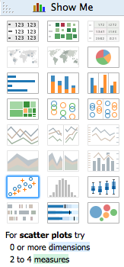
Grammar of Visualization

Slide 23
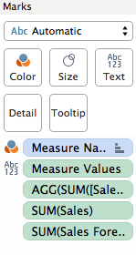
Grammar of Visualization

Slide 24
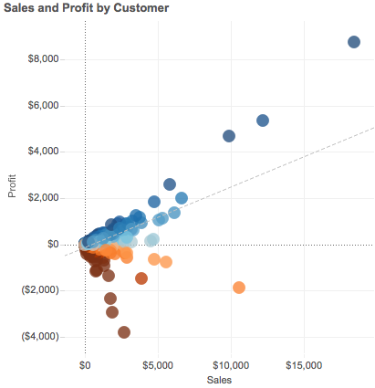
Grammar of Visualization

Slide 25
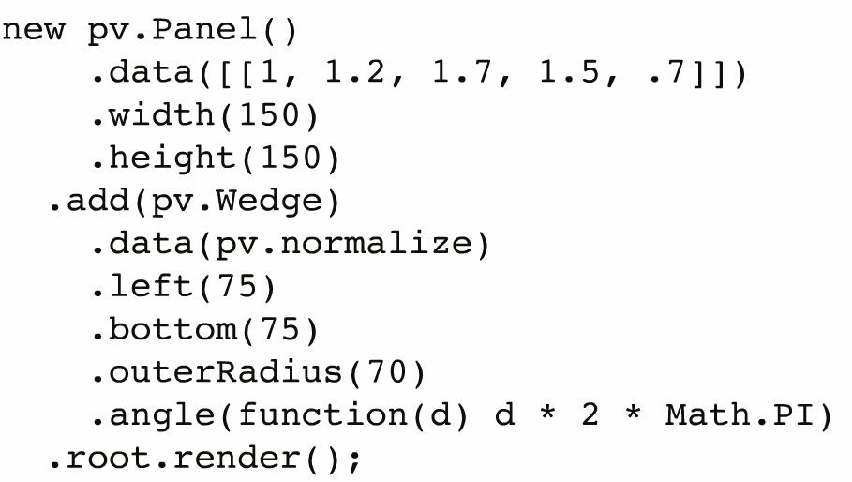
Grammar of Visualization
Notes:
protovis

Slide 26
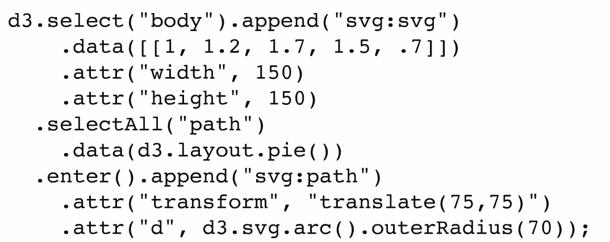
Grammar of Visualization
Notes:
and now, d3

Slide 27


